Slide 1
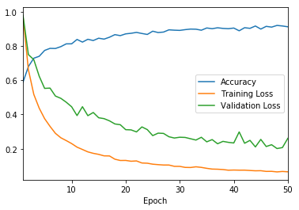
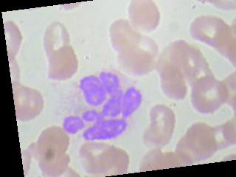
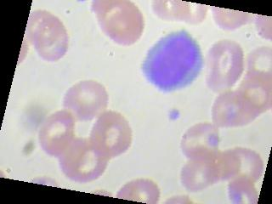
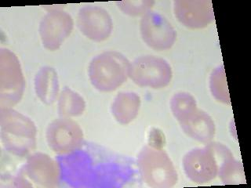
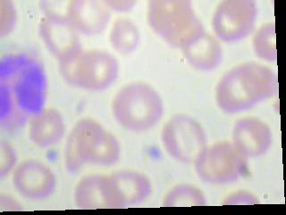

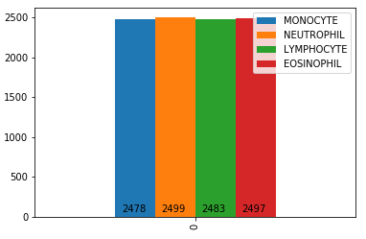
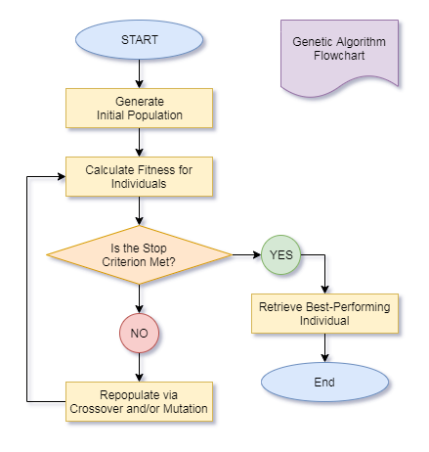
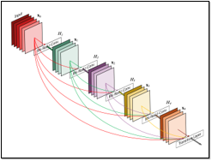
Blood Cell Type Classification
Using DenseNet and Genetic Algorithms
Joseph Erickson, Nathan Mathews, Anthony Keaveney
University of Rhode Island
DSP 461 – Fall 2019
Research Problem and Context
Methodology
Results
Medical science is a fast-growing field servicing an ever-growing population.
Reducing the time needed for lab sample processing can be crucial to administering effective treatment for patients.
Automation in the lab can help reduce these times and increase efficiency of patient care.
Our question: Can you train a neural network to distinguish between different types of blood cells?
Test out various approaches (regression, SVM) for initial results.
Use Google Colab for quicker runtimes.
Experiment and fine-tune hyperparameters for a neural network approach (# layers, layer widths, batch sizes, # epochs, validation %).
Implement a genetic algorithm to find hyperparameters that maximize testing accuracy.
Best-performing model with this technique had 95% training accuracy, 48% testing accuracy.
For all methods tested: ~60% testing accuracy.
Low training / validation loss, high testing loss (overtraining).
Genetic algorithm proved to do little better than random weight values.
Model
Data
DenseNet161^{[2]} neural network with 5 linear hidden layers.
NLLLoss^{[3]} with Adam optimizer.
50 epochs, batch size 800, ~9% validation set.
Linear layers used in conjunction with LogSoftMax.
Genetic Algorithm^{[4]}
Generations of 10, each member a set of 5 layer widths.
The 3 top-performing members were carried over and used to populate the next generation.
1 member of each generation generated randomly.
Idea: Keep breeding the top-performing members until we reach optimal results.
We used the Blood Cell Images Kaggle dataset^{[1]} as the foundation for our implementation.
320x240 color images with 4 evenly distributed classes (Eosinophil, Lymphocyte, Monocyte, and Neutrophil).
9957 training images and 2487 testing images.
Our model transformed the data by applying random rotations, scaling to a size of 40x30, and normalizing images.
99,570 training images, 9957 validation images, 2487 testing images.
Discussion
Shrinking images drastically increased computation speed but lowered testing accuracy ~10%.
Increasing the number of training / validation images improved training accuracy but not testing accuracy.
Genetic algorithm hyperparameters need to be more fine-tuned for this specific problem.
The algorithm also likely needs to run longer to be effective.
Optimal DenseNet hyperparameters were not found for this problem, though reaching 90% testing accuracy is possible.^{[5]}
Considerations for Future Research:
Multi-class classification
Image detection^{[1]}
SVM implementation
Variations on hidden layers
Eosinophil
Lymphocyte
Monocyte
Neutrophil
References
https://www.kaggle.com/paultimothymooney/blood-cells/kernels
https://pytorch.org/hub/pytorch_vision_densenet/
https://medium.com/udacity-pytorch-challengers/a-brief-overview-of-loss-functions-in-pytorch-c0ddb78068f7
https://towardsdatascience.com/genetic-algorithm-implementation-in-python-5ab67bb124a6
https://www.kaggle.com/drobchak1988/blood-cell-images-acc-92-val-acc-90
https://pytorch.org/docs/stable.html

